Slide 1

Voter Behavior and Community Demographics: A methodological approach to analyzing the 2018 mid-term election results.
Christopher Johnson
GIS 6100
Spring 2019

Slide 2
Data Sets
Hillsborough County Tiger Shape files 2018
HilBlock
HilBlockGroup
Tlgdb_2018_1_12_fl.gdb
https://www.census.gov/geo/maps-data/data/tiger-geodatabases.html
Fact
Household income 2016 for block groups in Hillsborough County. https://factfinder.census.gov/faces/nav/jsf/pages/searchresults.xhtml?refresh=t
Polls_Geocoded
2018 election results by precinct in Hillsborough County.
https://dos.myflorida.com/elections/data-statistics/elections-data/precinct-level-election-results/

Slide 3
The Polygon Overlay Problem
When Boundaries Collide. Graaf, N., Evans, G., & Jansen, G. (2013).
Voters are organized into precincts. (387)
Precinct boundaries contain census blocks. These boundaries do not always line up with each other. (388).
Four proposed solutions:
Areal weighting (391)
Dasy-metric mapping (391)
Kriging (391)
Point Kriging (392)

Slide 4
Methodology – Base data
In order to create a logical relationship between demographic characteristics and voter behavior both datasets are placed within a geographic space. This is possible because both datasets have a geographic component.
The Census bureau produces shape files that can be used to spatially join standalone demographic data with a geographic feature.
Voter registration and election results can be organized by precincts. Each precinct is associated with a polling location. Each polling location has an address.

Slide 5
Methodology – Why logical relationships?
Logical design is the process of collecting data and creating new datasets for analysis. The validity of a created dataset is justified by adhering to principals of logical relationships.
A logical relationship is one where:
Each observation is unique and fixed.
Each observation can be further described by another dataset and retain it’s unique and fixed status.
Relationship effects can be measured across variables.

Slide 6
Methodology – Limitations and Assumptions
Limitations:
ACS grain level is block group and not block.
There is no corresponding feature that bridges block data to precincts.
Assumptions:
Demographic data is best understood as a measure of tendency and not accuracy.
Distance to polling location indicates likelihood to vote.

Slide 7
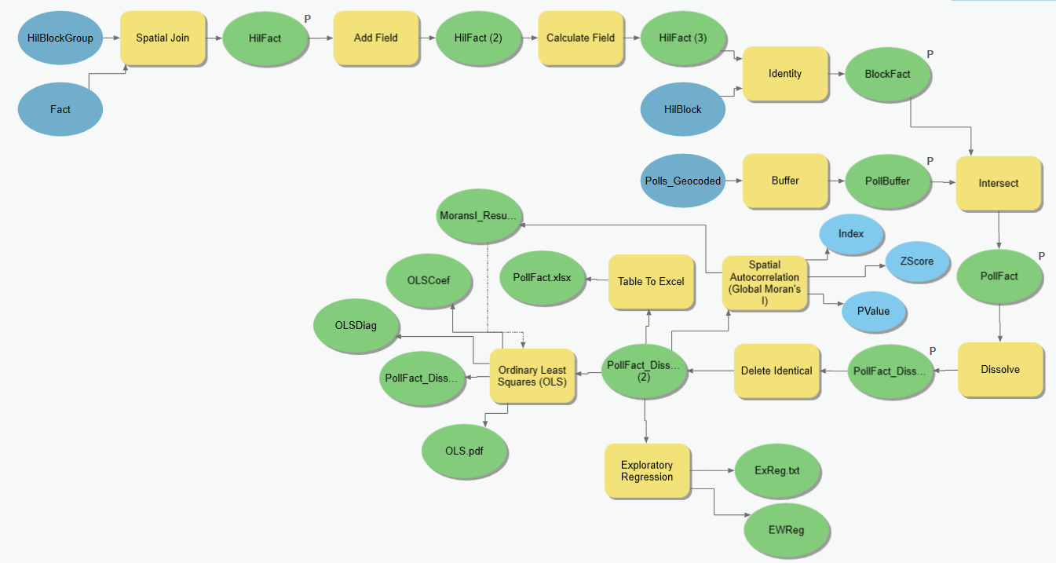
Methodology – Model Overview
Notes:
The model works like this:
The Fact table is the ACS demographic data for block groups in Hillsborough County in 2016. The HilBlockGroup table is the block group shape file for Hillsborough County in 2016. HilFact is created through the spatial join of these two tables and connects the shape file with the demographic data. HilBlock is the shape file for blocks in Hillsborough County in 2016. Identity is used to pass the HilFact values to the corresponding block in the block group. The Poll table has the election results for each polling location by address. X and Y values for Poll were created using the address attribute. A 2 mile buffer is created around each Poll observation creating the PollBuffer table. PollBuffer has all the attribute values of Poll. All BlockFact blocks that intersect PollBuffer are then associated with the respective PollBuffer element and create PollFact. All unique block observations within PollFact are then dissolved into a single element representative of a poll location. This collection of poll elements comprises PollFact_Dissolve. PollFact_Dissolve is then exported to excel for analysis in R.

Slide 8
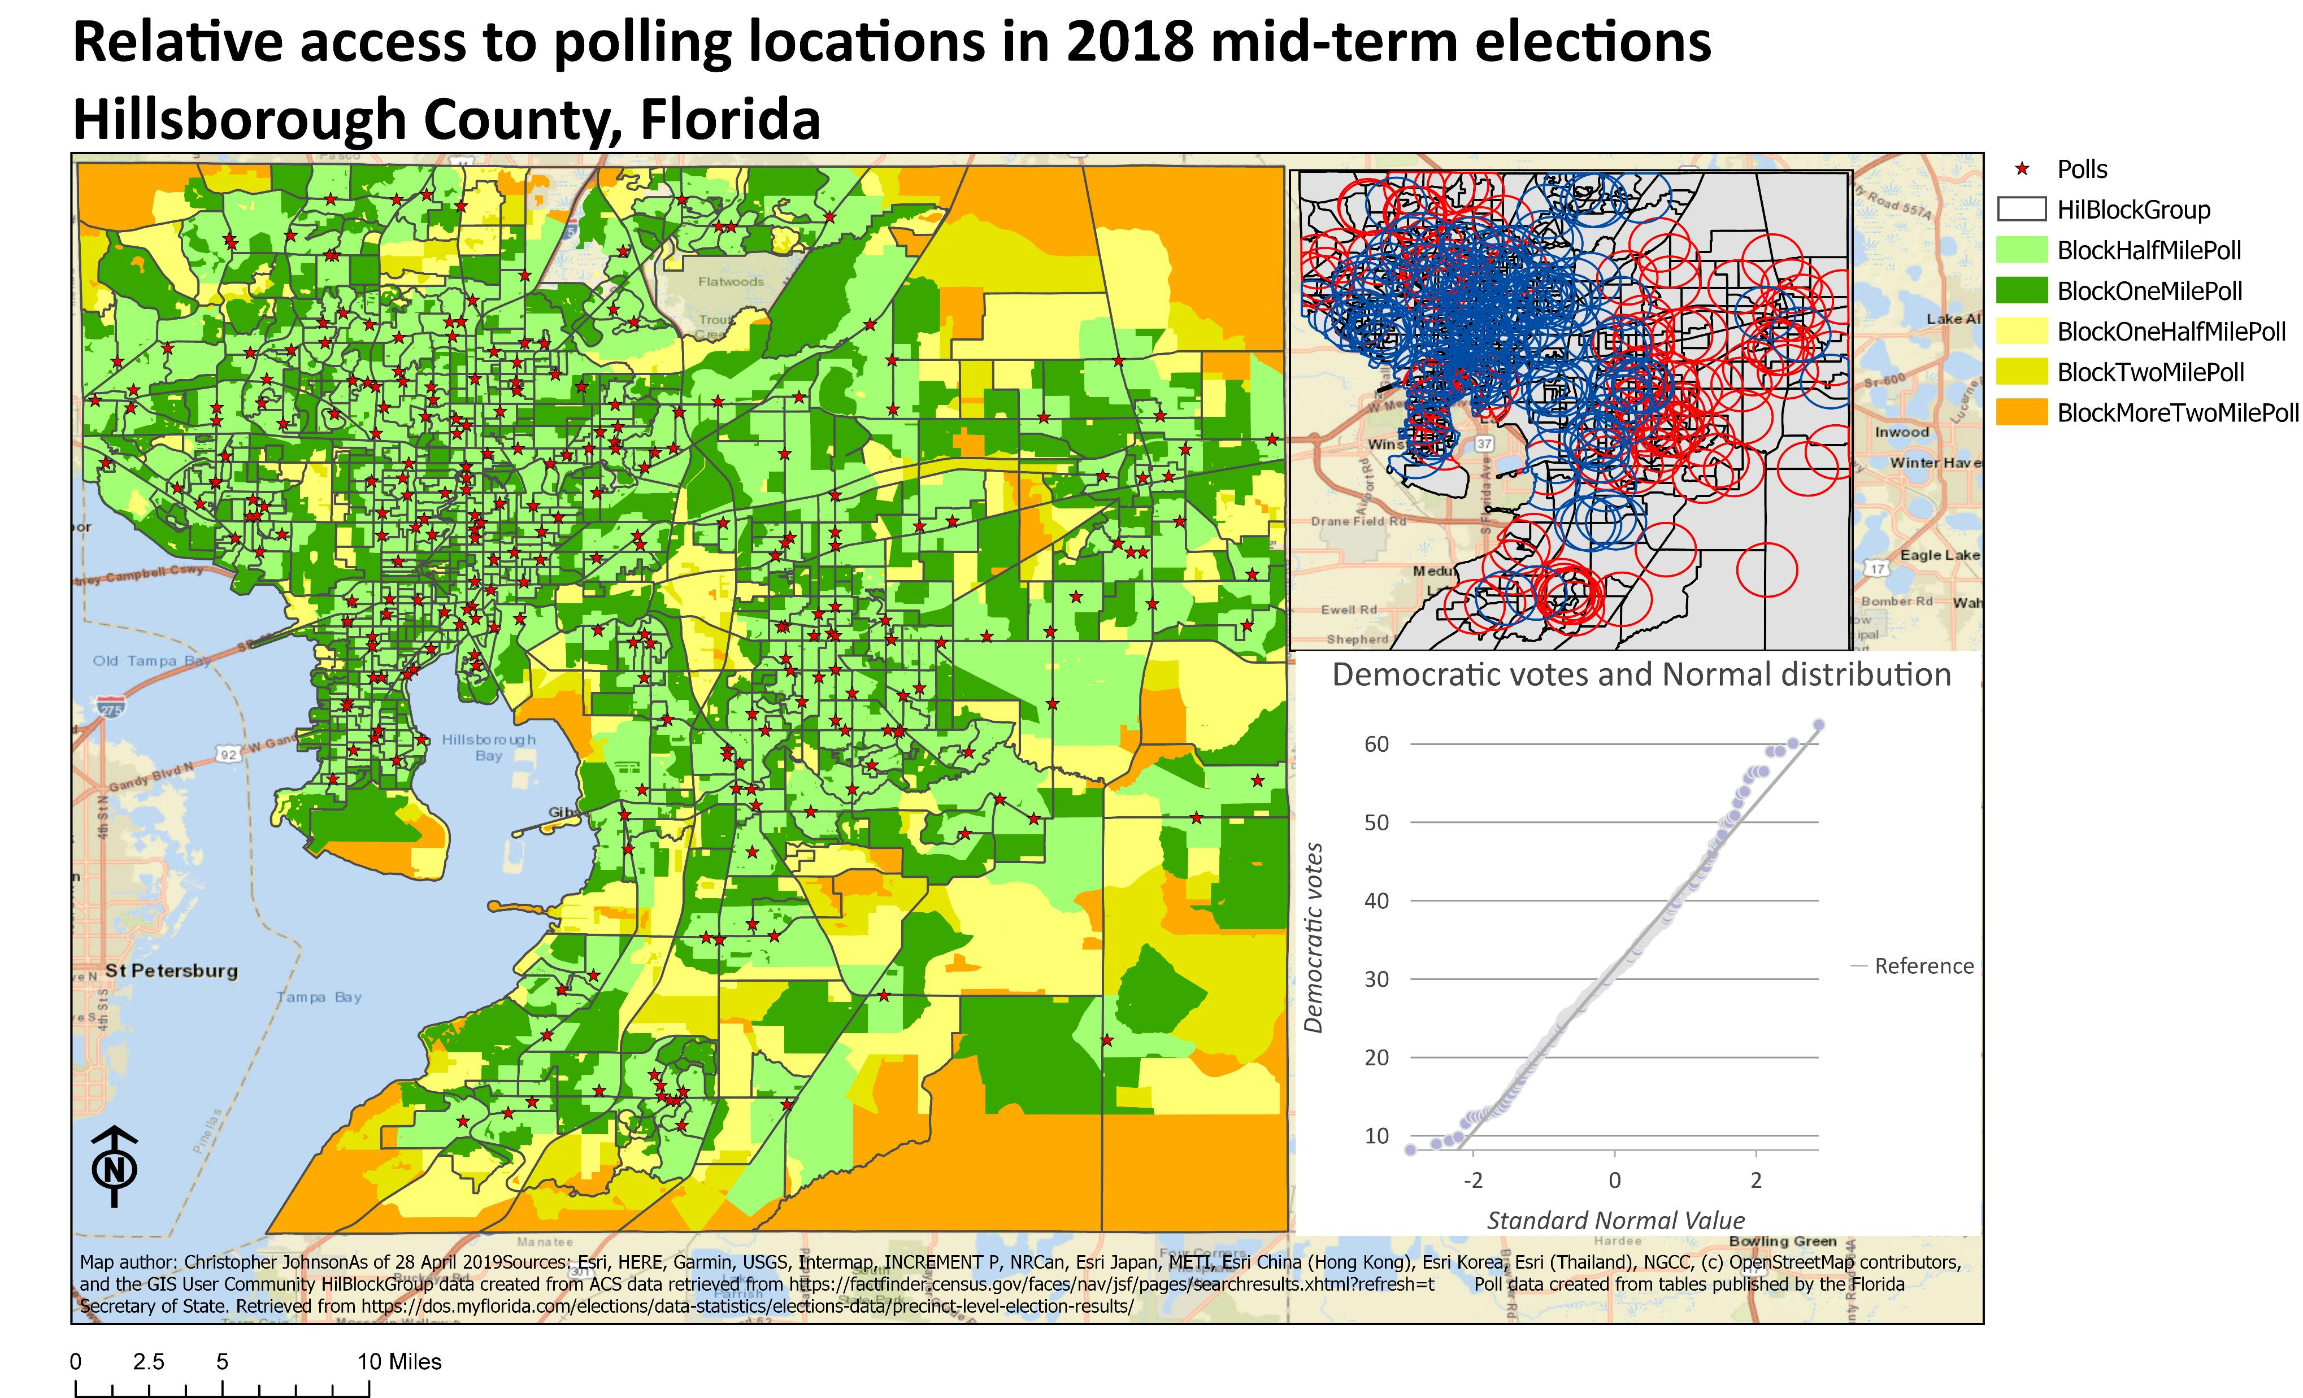

Slide 9
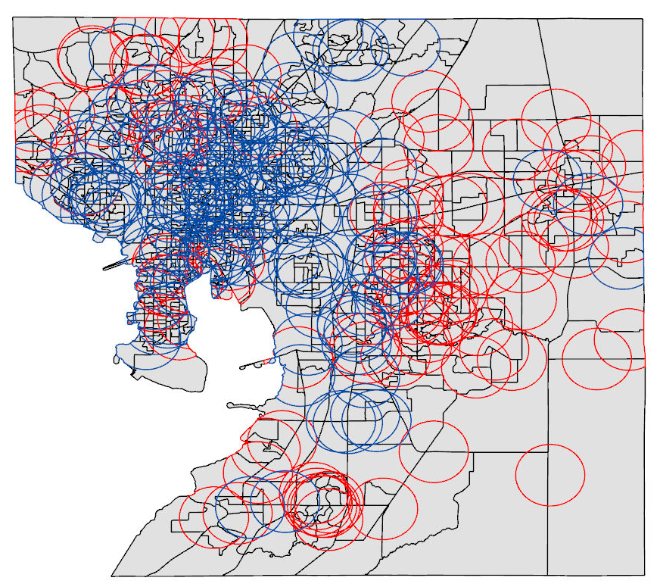
Methodology – Results
This is what the 2018 election looked like in Hillsborough County.
Each ring represents a polling location and a buffer with a 2 mile radius.
Blue for a Democrat vote rate >.5 of total vote. Red for Republican
Each ring contains the election results for that polling location as well as the mean value for all blocks that intersect the ring.
Each Block within a Block Group inherits the Block Group’s values.

Slide 10
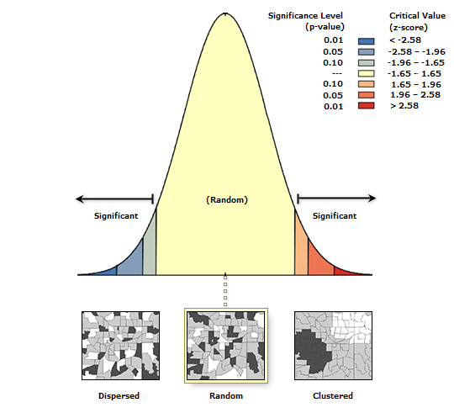
Results – Spatial Autocorrelation
Parameters
Conceptualization of Spatial Relationships: Inverse distance
Distance Method:
Euclidean
Standardization:
None

Slide 11
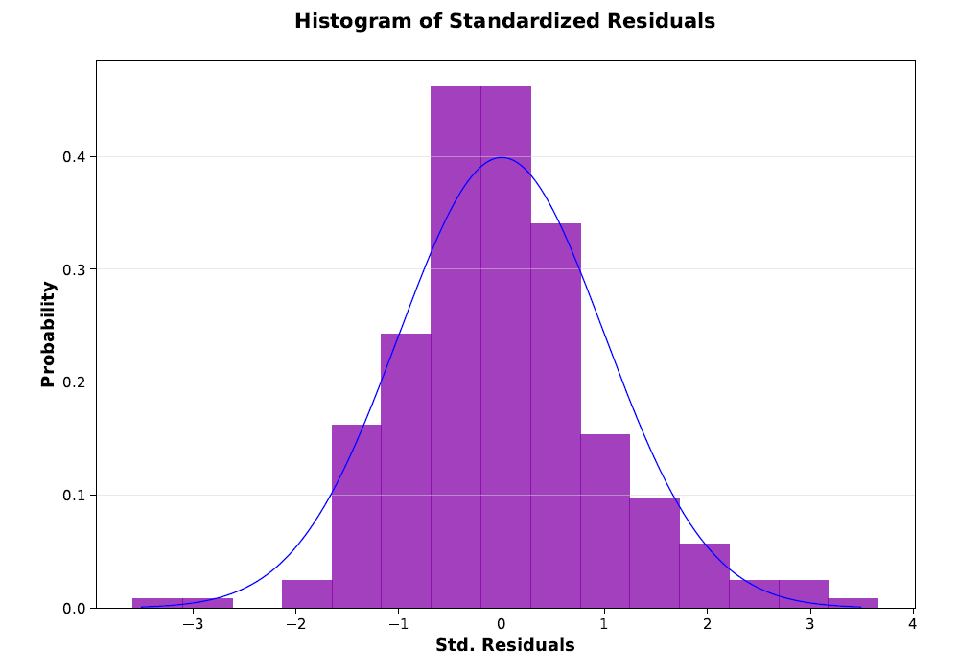
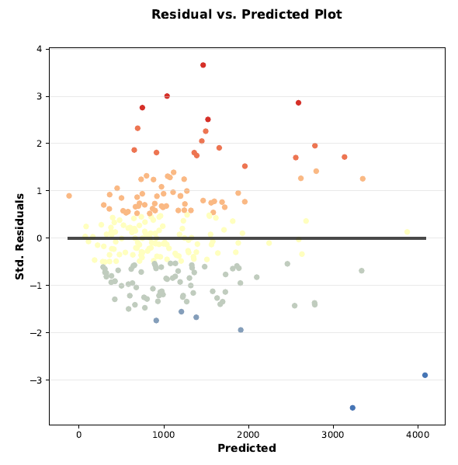
Results – Initial model

Slide 12
Conclusion
There appears to be a statistically significant relationship between the demographic data within a two mile radius of a polling location. Spatial autocorrelation is an effect on the model. This is mitigated by using the Spatial Autocorrelation function in ArcGIS Pro. There are strong indications that multicollinearity and heteroscedasticity exists in the dataset.
Follow on analysis in R is justified.
The model allows for automation to scale.

